Slide 1
Credit Card Fraud Detection Capstone Project

Slide 2
AGENDA
Objective
Approach
Model Building & Evaluation
Key Features
Cost – Benefit analysis
Recommendations
Notes:
Objective

Slide 3
Objectives
As a business analyst working for a financial provider company, I want to identify the possible root causes of the frequent fraudulent transactions
Build a fraud detection system using machine learning techniques to identify fraudulent activities at the right time and prevent them from happening.
Notes:
Objective

Slide 4
Approach
Step 1 : Understanding Data – Loading the data and understanding/generating the features.
Step 2 : Exploratory data analytics (EDA) – Performed univariate and bivariate analyses of the data, found key insights from the date
Step 3 : Train/Test Data Splitting
Stratified-KFold to split the train and validation data to get a balanced train and test data
Used the test dataset as the unseen data to validate the final model
Step 4 : Model Building and Hyperparameter Tuning – Tried different classification models and tuned the hyper parameters using GridSearchCV
Step 4 : Model Evaluation – Used confusion metrics and F1-Score/precision/recall to decide the final model to be selected. Also ran the model on unseen test data to evaluate the performance.
Step 5 : Business Impact – Based on the final model cost benefit analysis was performed to find out the savings by applying the machine learning algorithm to identity and prevent fraudulent transactions.
Notes:
Objective

Slide 5
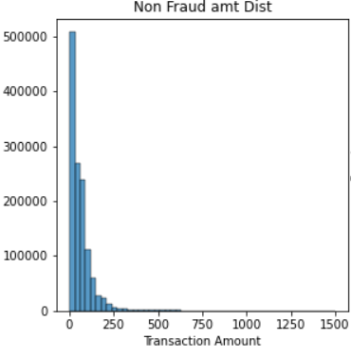
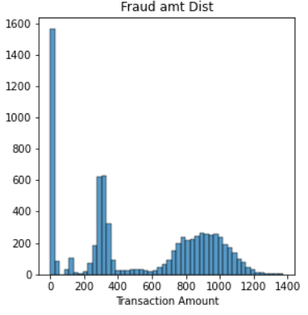
Transaction amounts are higher during fraud
Compared to non-fraud transactions, a greater number of higher value transactions are observed during fraud
Notes:
Objective

Slide 6
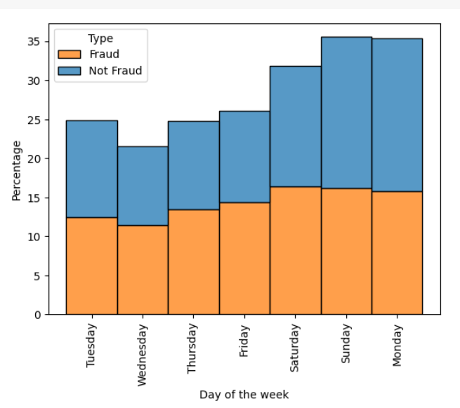
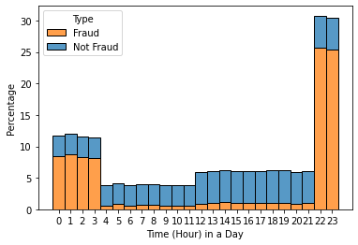
Weekends/odd hours witness more fraudulent transactions
Off peak hours are selected to perform most of the fraud transactions
More number of fraudulent transactions takes place majorly on Saturdays and Sundays followed by Monday.
Notes:
Objective

Slide 7
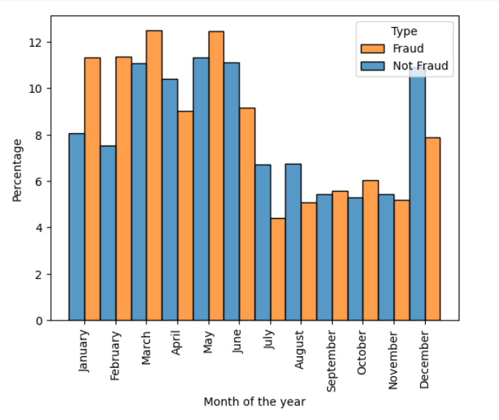
More fraudulent transactions at the beginning of the year
We see the number of frauds are higher the beginning months of the year. Whereas the frauds are way lesser after June.
Notes:
Objective

Slide 8
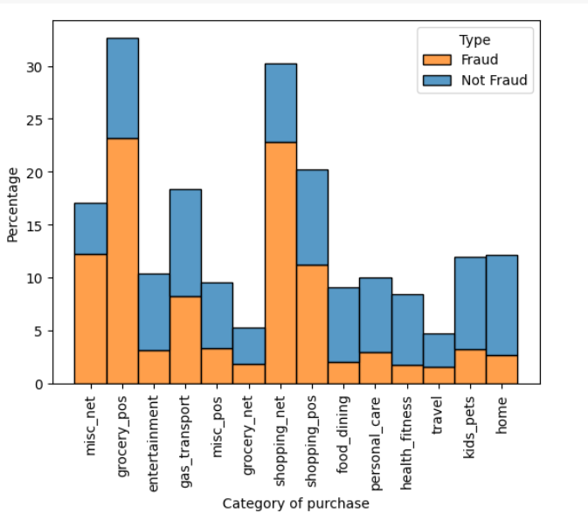
Frauds higher in grocery and shopping purchases
Grocery pos machines and shopping network have the highest fraudulent transactions among the category of purchases.
Notes:
Objective

Slide 9
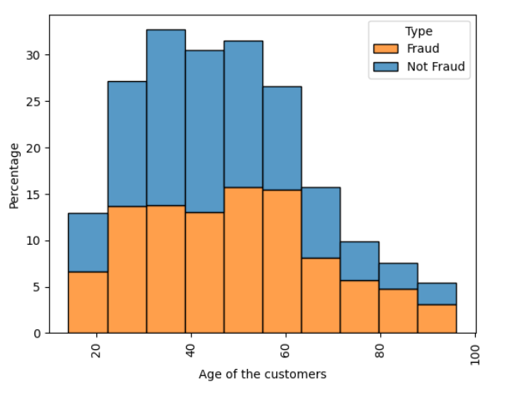
People with age above 40 years are subjected to fraud
From the analysis we see that customers in the age group of 40-60 years are victims of frauds
Notes:
Objective

Slide 10
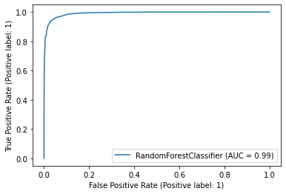
Model Building & Evaluation
Three models - Logistic Regression, Decision Tree and Random Forest were used for training
Stratified K-Fold cross validation is used to maintain the same ratio of classes as per the original dataset
Random Forest with SMOTE resampling technique performed the best based on the evaluation metrics
Average Accuracy: 93.6%
Average F1 Score: 93.2%
Average Precision Score: 98.3%
Average Recall Score :88.7%
AUC value of 0.99 indicates good performance of the model
Evaluated the performance with unseen data
Notes:
Objective

Slide 11
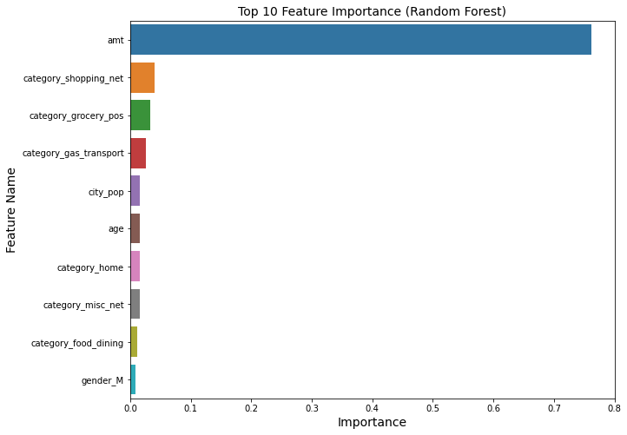
Key Features
Transaction Amount, categories like shopping, gas and grocery are the top features that influence the model
Notes:
Objective

Slide 12
Cost – Benefit Analysis
Cost incurred per month before model deployment : $213,389
If the model was used during the same duration(24 months), cost incurred (per month): $29,263
Potential savings per month with using model : $184,126
Business can detect and prevent 87% of the frauds using the model
Notes:
Objective

Slide 13
Recommendations
Automation in detecting the fraud is mandatory to prevent frauds
Using the modeling can prevent 87% of the frauds at the origin itself
Bank can make significant savings by deploying the ML based automated fraud detection system
Bank should educate the customers and customer support executives on how to respond to automate fraud alerts generated by the ML model
Bank should retrain/redeploy the model in future to enhance the fraud detection capability
Notes:
Objective

